Slide 1


Slide 2


Business Etiquette - 2

Slide 3
BUSINESS BLOG
Business blogging is a marketing tactic that uses blogging to get your business more online visibility. A business blog is a marketing channel(just like social media, direct mail,email marketing,etc.) that helps support business growth.

Slide 4
The Benefits of Blogging for Business
1. It helps drive traffic to your website.
They could type your name right into their browser, but that's for an audience you already have. They know who you are, you're on their radar, and that doesn't help you get more traffic on top of what you're already getting.
blogging is a great way to solve both of those problems.
Every time you create and publish a blog post, it's one more indexed page on your website, which means one more opportunity for you to show up on the search engine results page (SERP) and drive traffic to your website in organic search.

Slide 5
2. You can repurpose blog content for social media.
Every time you create a new article, you're creating content that people can share on social networks — Twitter, LinkedIn, Facebook, Pinterest — which helps expose your business to a new audience that may not know you yet.
Instead of asking your social media manager always to create brand new content for social media (or creating that content yourself), your blog can serve as that repository of content.

Slide 6

DEVELOPING A BRAND MESSAGE

Slide 7
Preface
In today's competitive landscape, a strong brand message is essential for businesses of all sizes.
It's the core of your communication strategy, influencing how your audience perceives your company.
This presentation will explore the importance of business etiquette in crafting a compelling and effective brand message.

Slide 8

What is Branding in general?
Branding is the process of creating a distinct identity for a business in the minds of your target audience and the general population.
At its core, branding consists of a company's name and logo, visual identity design, mission, values, and tone of voice

Slide 9

BUSINESS ETIQUETTE IN BRAND MESSAGING
Business etiquette plays a crucial role in brand messaging because it ensures consistency and professionalism in all your communications.
When you consistently use proper etiquette, it reflects positively on your brand's values and culture.
This, in turn, builds trust and credibility with your audience.

Slide 10

TARGET AUDIENCE
Before crafting your brand message, it's vital to understand your target audience.
Consider their demographics, needs, interests, and preferred communication style.
Knowing your audience allows you to tailor your message to resonate with them and achieve your communication goals.

Slide 11
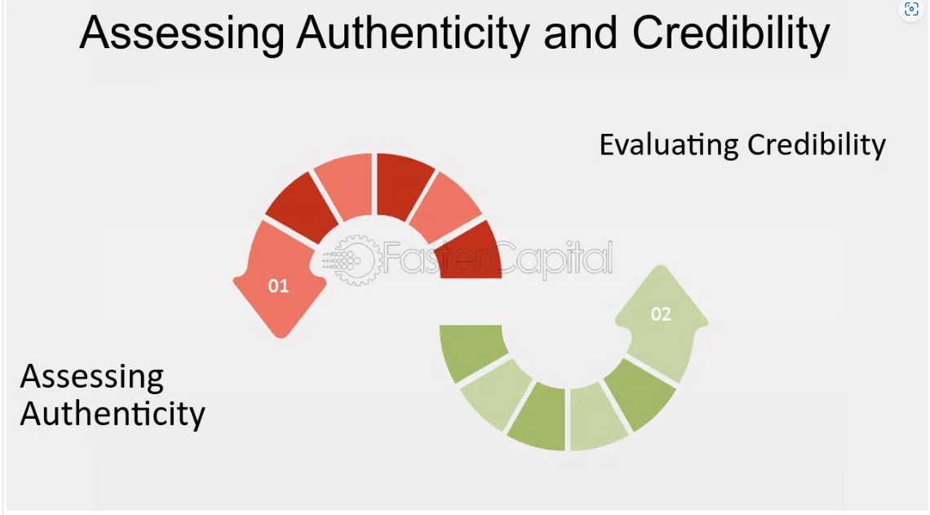
AUTHENTICITY AND CREDIBILILTY
Consumers are drawn to brands that feel authentic and credible.
Let your brand personality come through in your message, but ensure you can support your claims with verifiable evidence.
Transparency and honesty go a long way in building long-term trust.

Slide 12
CONSISTENCY IS THE KEY
Consistency is key in brand messaging.
Brand consistency refers to the uniformity and coherence in the way a brand presents itself across various touch points and communication channels.
Your audience should encounter the same core message regardless of whether they interact with you online, in person, or through marketing materials.
This consistency builds brand recognition and reinforces your message.

Slide 13
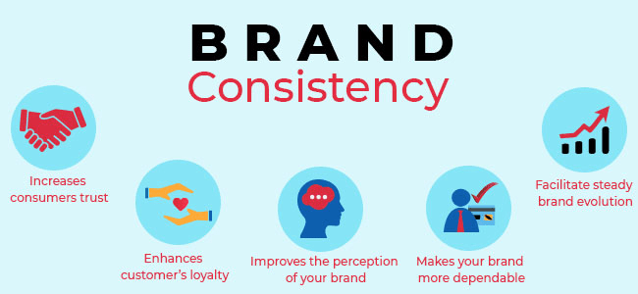

Slide 14
WAYS TO DEVELOP YOUR BRAND
1. Define Your Purpose
2. Assess Market Opportunity
3. Create Value for Customers
4. Create Value for Suppliers
5. Create Value for Employees
6. Design your short- and long-term plan.
7. Build your business force.

Slide 15
THE POWER OF STORY TELLING
Storytelling is a powerful tool for communicating your brand message.
Stories can connect with your audience on an emotional level and make your message more memorable.
Use stories to showcase your brand values, mission, and how you help your customers.

Slide 16

THE STORY OF THE BRANDING KING – ‘THE TERMINATOR’

Slide 17
LVMH BUSINESS MODEL
Brand Portfolio: LVMH boasts an impressive portfolio of luxury brands spanning multiple industries, including fashion, spirits, perfumes, cosmetics, watches, and jewelry.
This brand diversification allows LVMH to cater to various consumer preferences and capture market share across different segments.
Brand Autonomy: LVMH allows its brands a degree of autonomy when it comes to design and creative decisions. This approach preserves the unique identity and heritage of each brand within the portfolio.

Slide 18
LVMH BUSINESS MODEL
Retail Presence: LVMH maintains an extensive network of retail stores worldwide, allowing them to engage directly with consumers and create immersive brand experiences
Innovation and Creativity: LVMH places a strong emphasis on innovation and creativity, constantly pushing the boundaries of luxury. This commitment to innovation has enabled the company to stay ahead of competitors and adapt to changing consumer preferences.

Slide 19
FAQ’S & ASSESSING COMPETITION
FAQs, or Frequently Asked Questions, are a crucial component for any business looking to enhance customer experience, improve efficiency, and boost sales.
A well-crafted FAQ page empowers customers to find answers to common questions independently. This saves them time and frustration compared to contacting customer service.

Slide 20
FAQ’S
Transparency:FAQs provide a platform to address potential concerns and buying hesitations proactively. This builds trust and fosters a positive customer experience.
24/7 Availability: FAQs are accessible anytime, anywhere, catering to customers who may have questions outside of business hours.

Slide 21
Increased Efficiency:
Reduced Support Load: By deflecting repetitive inquiries, FAQs free up customer service representatives to handle more complex issues. This translates to faster resolution times and improved overall efficiency.
Proactive Problem Solving: FAQs can anticipate potential roadblocks customers might face and offer solutions upfront. This reduces the need for back-and-forth communication

Slide 22
Informed Decisions: Clear and concise answers to product or service questions can help nudge customers towards a purchase decision with more confidence.
Reduced Friction: Addressing potential buying objections through FAQs can remove obstacles in the sales funnel and lead to higher conversion rates.
SEO Benefits: Well-structured FAQs with relevant keywords can improve search engine ranking, making your business more discoverable by potential customers.

Slide 23
How to streamline your FAQs?
Keep it Updated: Regularly review and update your FAQs to ensure they reflect current offerings, policies, and address emerging customer questions.
User-Friendly Design: Make your FAQ page easy to navigate with clear categories, search functionality, and concise answers.
Mobile-Optimized: Ensure your FAQ page is accessible and readable on all devices, especially smartphones.
By leveraging the power of FAQs, you can create a smoother customer journey, streamline operations, and ultimately drive business growth.

Slide 24
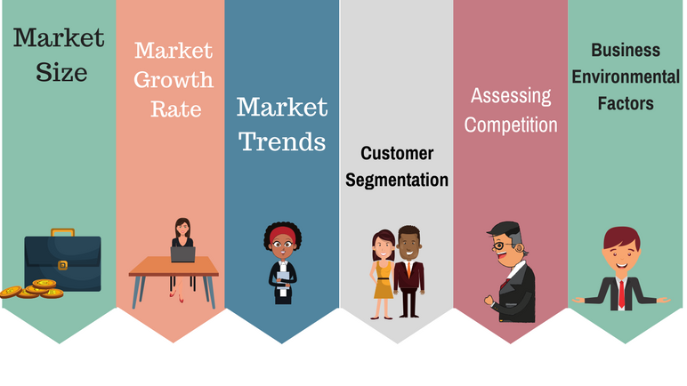
ASSESSING COMPETITION

Slide 25
IMPORTANCE OF ASSESSING THE MARKET CONDITION
Identify Opportunities and Threats: By understanding the market landscape, you can spot promising opportunities for growth, new markets to enter, or gaps in customer needs that your business can address.
On the flip side, you can also anticipate potential threats like new competitors, economic downturns, or changing customer preferences.

Slide 26
IMPORTANCE OF ASSESSING THE MARKET CONDITION
Stay Competitive: The market is dynamic, and successful businesses need to be adaptable. Regularly assessing market conditions allows you to stay on top of trends, understand your competitors' moves, and adjust your approach accordingly.
Attract Investors: If you're seeking investment, a thorough market assessment demonstrates to potential backers that you have a deep understanding of the market dynamics and a realistic plan for success.

Slide 27
IMPORTANCE OF ASSESSING THE MARKET CONDITION
Optimize Performance: By understanding the market, you can benchmark your performance against competitors and identify areas for improvement.
This can help you refine your marketing strategies, improve efficiency, and ultimately boost your bottom line.
Inform Strategic Decisions: Having a clear picture of the market empowers you to make informed decisions about your business strategy.
This can involve anything from pricing and product development to marketing campaigns and resource allocation.

Slide 28



CASE STUDY

Slide 29

BRAND LOGOS

Slide 30
DEFINE YOUR BRAND STRATEGY
Set of questions for the brand and answer to these questions will define your strategy.
1. What are the value of the product?
2. What is the purpose of the product?
3. What is the customer segment?
4. Taste & preferences of your customer?
5. Your promise to the customer?

Slide 31
QUESTION 1
What is the purpose of conducting competitive assessment in business?
A. To ignore competitors completely and focus solely on internal operations
B. To understand the strengths and weaknesses of competitors in the market
C. To copy exactly what competitors are doing without analysis
D. To underestimate the competition to appear superior
Notes:
ANS: B

Slide 32
QUESTION 2
In the context of brand messaging, what aspect does the 'Competitive Angle' typically analyze?
A. Internal employee engagement
B. Competitor positioning and differentiation
C. Customer satisfaction levels
D. Market growth potential
Notes:
ANS: B

Slide 33
QUESTION 3
What is a fundamental step in establishing a strong online presence and managing one's online identity effectively?
A. Establishing Home Base Online
B. Avoiding any online presence altogether
C. Sharing personal information on all social media platforms
D. Creating multiple anonymous accounts
Notes:
ANS: A

Slide 34
QUESTION 4
What aspect of online presence management involves evaluating and potentially adjusting how one presents themselves across various social media platforms?
A. Ignoring feedback and comments from followers
B. Consistently posting without analyzing engagement metrics
C. Creating new accounts frequently without updating existing ones
D. Identity Review and Reshaping
Notes:
ANS: D

Slide 35
QUESTION 5
How can a company's brand message effectively connect with customers and build brand loyalty?
Consistent Messaging Across All Channels
Engaging Storytelling
High-Quality Products and Services
Personalized Customer Experience
Notes:
ANS: B

Slide 36
QUESTION 6
What is a key aspect to consider when creating a brand message for a company?
A. Price competitiveness
B. Brand loyalty
C. Sales growth
D. Company success
Notes:
ANS: B

Slide 37
QUESTION 7
Alice, a marketing manager at eTHNUS, is preparing to meet with potential investors. She's tasked with conveying the company's brand message and assessing competitors. Her online profiles are outdated, and she has limited data on market competition.
How can Alice perform a competitive assessment with limited data?
Alice can use analytical writing to synthesize available information
Analyze Competitors' Social Media
Conduct Customer Surveys
Network with Industry Peers
Notes:
ANS: A

Slide 38
QUESTION 8
What role do FAQs play in managing a company's blog and online presence?
to proactively address common questions, concerns, or pain points that customers may have.
Establish Authority and Trust
Enhance User Experience
Improve SEO
Notes:
ANS: A

Slide 39
QUESTION 9
How often should new content be published?
Daily
Weekly
Bi-weekly
Monthly
Notes:
ANS: B

Slide 40
QUESTION 10
What tone and style should the blog adopt?
Formal
Conversational
Humorous
Mixed
Notes:
ANS: D

Slide 41
QUESTION 11
What is the blog’s unique selling proposition (USP)?
Comprehensive guides
Experts insights
Interactive content
All the above
Notes:
ANS: D

Slide 42
QUESTION 12
What are the basic guidelines for blog writing?
Think about your audience
Memorize the content
Refer from the books
All the above
Notes:
ANS: A

Slide 43
QUESTION 13
What ar the principles of an blog?
Be honest about what i know
Try to not write anything (too) wrong
Be positive
All the above
Notes:
ANS: D

Slide 44
QUESTION 14
What is the secret of blogging?
long passage
Use short sentence and paragraphs
Short names
None of the above
Notes:
ANS: B

Slide 45
QUESTION 15
What makes blogs popular?
Engaging content
Using keywords
Creating quality backlines
writing for Search Engines
Notes:
ANS: D

Slide 46
THANK YOU

Slide 47
